Slide 1
SINGULAR VALUE DECOMPOSITION (SVD)
Anders Arnold
Varun Singh
Gourab Sarkar
Nikita Jetwani

Slide 2
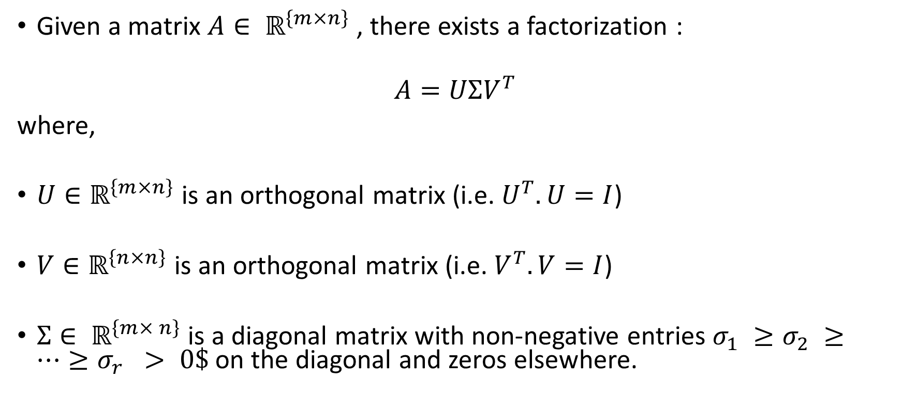
What is Singular Value Decomposition ?
Given a matrix $A∈ ℝ^{\left\{m×n\right\}}$, there exists a factorization :
$$A=UΣV^{T}$$
where,
$U∈ℝ^{\left\{m×n\right\}}$ is an orthogonal matrix (i.e. $U^{T}. U=I$)
$V∈ℝ^{\left\{n×n\right\}}$ is an orthogonal matrix (i.e. $V^{T}. V=I$)
$Σ∈ ℝ^{\left\{m× n\right\}}$is a diagonal matrix with non-negative entries $σ_{1} ≥σ_{2} ≥…≥σ_{r} > 0\$$on the diagonal and zeros elsewhere.

Slide 3
Why is it useful ?
Every real matrix has a Singular Value Decomposition.
Using this matrix decomposition, we can represent a matrix as a product of two orthogonal matrices and a diagonal matrix.
Orthogonal and diagonal matrices are special, well-structured, and useful matrices with special properties.
These special properties can be exploited in many situations which makes this decomposition particularly useful.

Slide 4
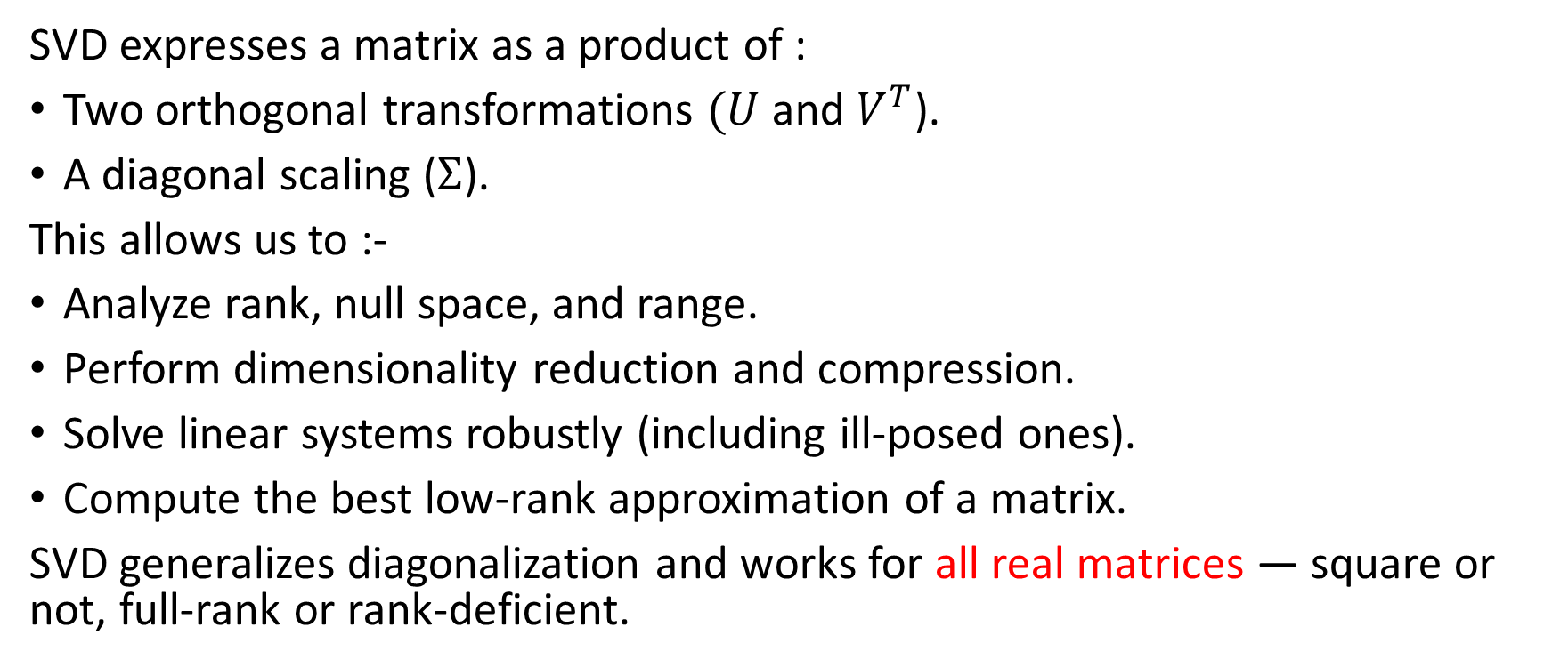
Why Do We Factorize a Matrix This Way ?
SVD expresses a matrix as a product of :
Two orthogonal transformations $(U$ and $V^{T}$).
A diagonal scaling ($Σ$).
This allows us to :-
Analyze rank, null space, and range.
Perform dimensionality reduction and compression.
Solve linear systems robustly (including ill-posed ones).
Compute the best low-rank approximation of a matrix.
SVD generalizes diagonalization and works for all real matrices — square or not, full-rank or rank-deficient.

Slide 5
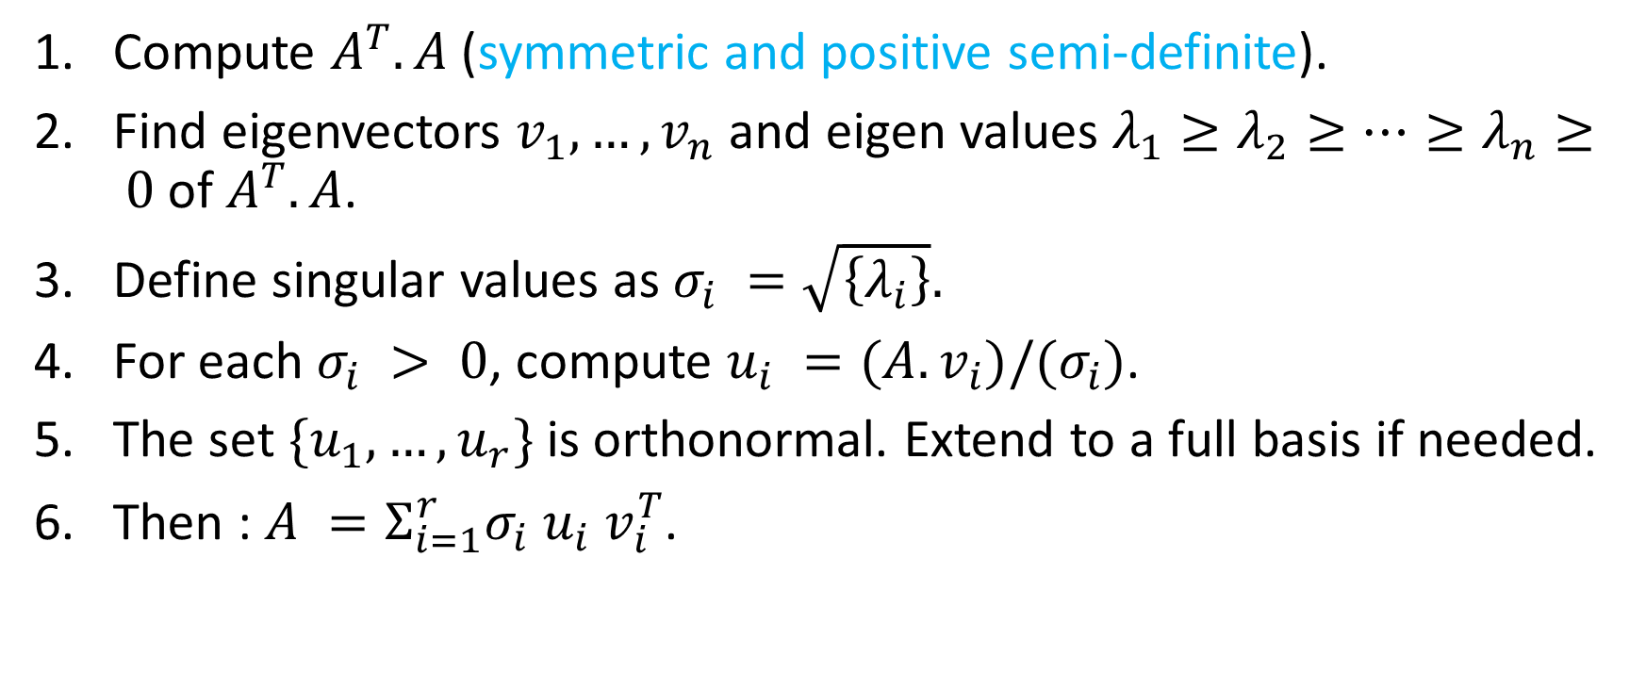
Mathematical Procedure
Compute $A^{T}.A$(symmetric and positive semi-definite).
Find eigenvectors $v_{1}, …, v_{n}$ and eigen values $λ_{1}≥λ_{2}≥…≥λ_{n}≥ 0$of $A^{T}.A$.
Define singular values as $σ_{i} =\sqrt{\left\{λ_{i}\right\}}.$
For each $σ_{i} > 0$, compute $u_{i} =(A.v_{i})/(σ_{i})$.
The set $\{u_{1}, …, u_{r}\}$is orthonormal. Extend to a full basis if needed.
Then : $A =Σ_{i=1}^{r}σ_{i} u_{i} v_{i}^{T}$.

Slide 6
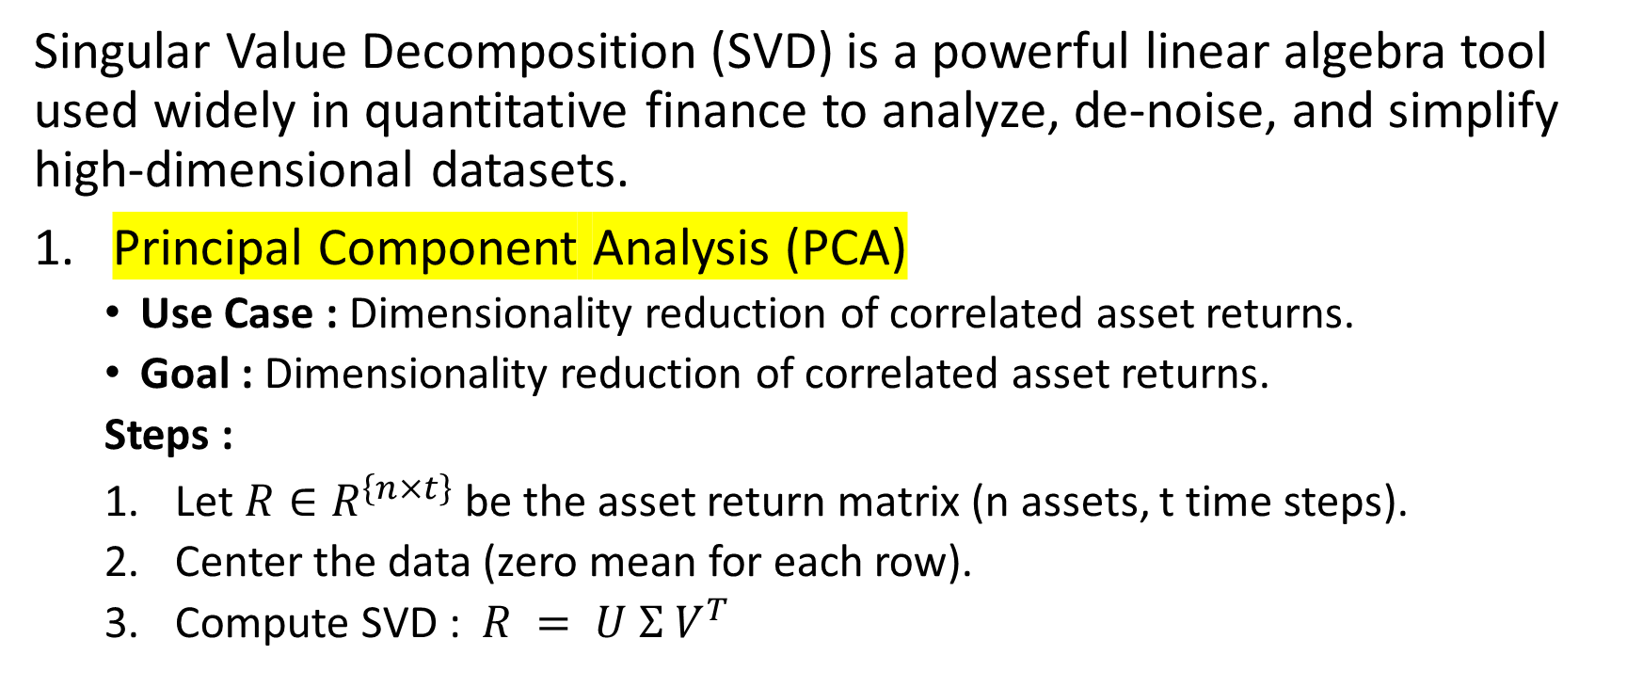
Applications in Quantitative Finance
Singular Value Decomposition (SVD) is a powerful linear algebra tool used widely in quantitative finance to analyze, de-noise, and simplify high-dimensional datasets.
Principal Component Analysis (PCA)
Use Case : Dimensionality reduction of correlated asset returns.
Goal : Dimensionality reduction of correlated asset returns.
Steps :
Let $R∈R^{\left\{n×t\right\}}$be the asset return matrix (n assets, t time steps).
Center the data (zero mean for each row).
Compute SVD : $R = U Σ V^{T}$

Slide 7
Applications in Quantitative Finance
4. The columns of $V$ are principal components; singular values tell their importance.
Example: Reduce 500 S&P 500 stocks to 3 main components (e.g., growth, value, volatility).
2. Factor Models and Risk Decomposition
Use Case : Extract systematic risk factors.
Goal : Express asset returns as a combination of a few orthogonal latent risk factors. SVD helps identify these directions and quantify exposure.
Example : Estimate factor exposures (like Fama–French) from historical returns using SVD.

Slide 8
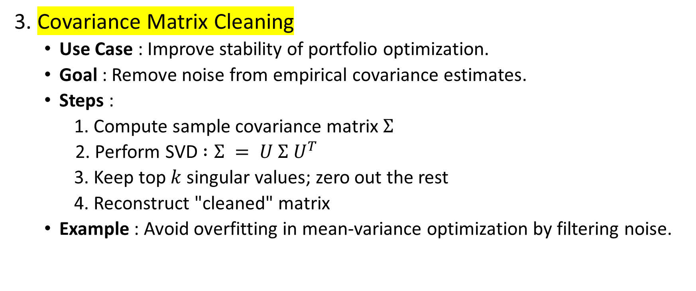
Applications in Quantitative Finance
3. Covariance Matrix Cleaning
Use Case : Improve stability of portfolio optimization.
Goal : Remove noise from empirical covariance estimates.
Steps :
1. Compute sample covariance matrix $Σ$
2. Perform SVD $:Σ = U Σ U^{T}$
3. Keep top $k$ singular values; zero out the rest
4. Reconstruct "cleaned" matrix
Example : Avoid overfitting in mean-variance optimization by filtering noise.

Slide 9
Applications in Quantitative Finance
4. Portfolio Compression / Approximation
Use Case : Represent large portfolios using fewer synthetic instruments.
Goal : Approximate exposure using fewer components. SVD can express the portfolio weights matrix as a low-rank sum.
Example : Replace 100-asset portfolio with 5 "principal" portfolios having similar exposure.
5. Latent Alpha Signal Discovery
Use Case : Analyze alternative data (price-volume, sentiment, etc.)
Goal : Extract dominant signals or latent factors. SVD applied to a time-series × features matrix can reveal patterns not visible directly.
Example : Decompose a matrix of trading signals to isolate the most predictive factors.

